Slide 1


Slide 2
Agenda
Overview
What is the need?
Getting started with Git and Stash
Pull requests in Stash
JIRA/Bamboo integration
Stash Administration

Slide 3

Overview
Belongs to Atlassian Software Systems, founded by Scott Farquhar and Mike Brookes in 2002.
In 2012, Atlassian released Stash to manage Git repositories

Slide 4
What is Stash?
Atlassian Stash is the on-premises Git repository management solution for enterprise teams.
It allows everyone in your organization to easily collaborate on your Git repositories.
On-premises source code management for Git that's secure, fast, and enterprise grade.
There are an endless number of Git workflows, and Stash works with them all

Slide 5
What is the need?
Get fit in small or enterprise environment
Allows everyone in your organization to easily collaborate on your Git repositories.
A perfect user management local as well as centralized using JIRA
Good combination of code review and collaboration
Traceability over issues and sources
Support of Add-ons and hooks

Slide 6
Stash Features
User Authentication
Create a repository and get your code into Stash
Creating personal repositories
Repository hooks
Using branches in Stash
Forks in Stash

Slide 7
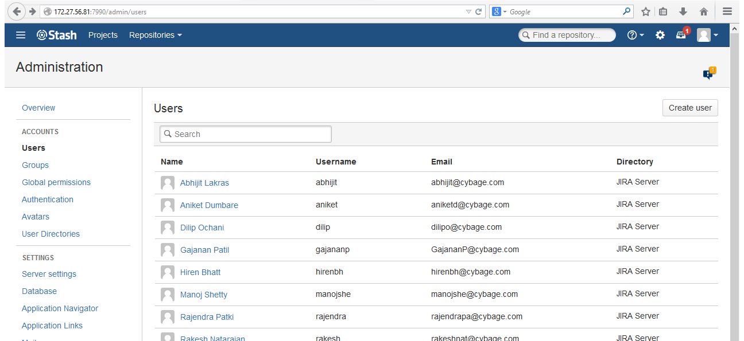
User Management
Stash Administration

Slide 8

User Management

Slide 9
User Authentication
User Authentication
System Administrator
Administrator
Project Creator
Stash User
Project Access
Admin
Write
Read
Admin: can create, edit and delete repositories and projects, and configure permissions for projects.
Write: can push to and pull from all the repositories in the project.
Read: can only browse code and comments in, and pull from, the repositories in the project.

Slide 10
User Authentication
User Authentication
System Administrator
Administrator
Project Creator
Stash User
Project Access
Admin
Write
Read
System Administrator: can access all the configuration settings of the Stash instance.
Administrator: same as System Admins, but they can't modify file paths or the Stash server settings.
Project Creator: can create, modify and delete projects.
Stash User: active users who can access Stash.

Slide 11
Create a Repository
Import an existing, un-versioned code project to an empty repository
If you have code on your local machine that is not under source control, you can put it under source control
Import a Git project to an empty repository
You can import an existing repository into an empty project in Stash.
Mirror an existing Git repository
You can mirror an existing repository into a repository hosted in Stash.
Import it into Stash.
When you do this, Stash maintains your commit history.

Slide 12
Create a Repository

Slide 13

Personal Repository
Unrelated to other projects
You can use for storing private snippets of work
By default, personal repositories are not visible to other Stash users.
However, you can:
use repository permissions to open up access to other Stash users and groups, for collaboration or review.
allow public access (read-only) to your project, for anonymous users.

Slide 14
Creating a Personal Repository
You can create personal repositories by:
Directly, from your profile.
By forking another repository.

Slide 15
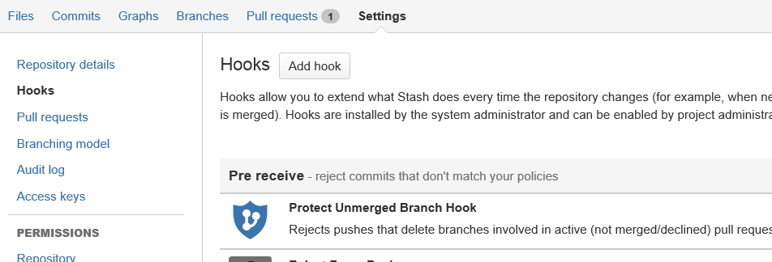
Repository Hooks
Provide a way to customize a team's workflow and integrate with other systems.
Are enabled separately on each repository in a project.

Slide 16
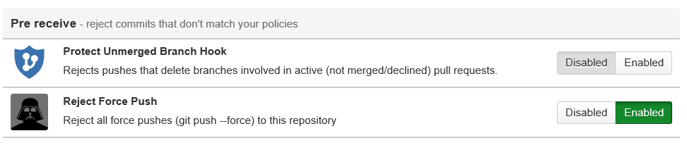
Pre-receive hooks
The first hook to run when handling a push from a client is the pre-receive hook.
Can reject pushes to the repository if certain conditions are not fulfilled.

Slide 17
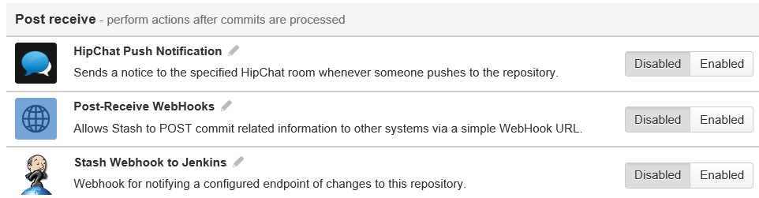
Post-receive hooks
The post-receive hook runs after the commits have been processed
Can be used to update other services or notify users.

Slide 18
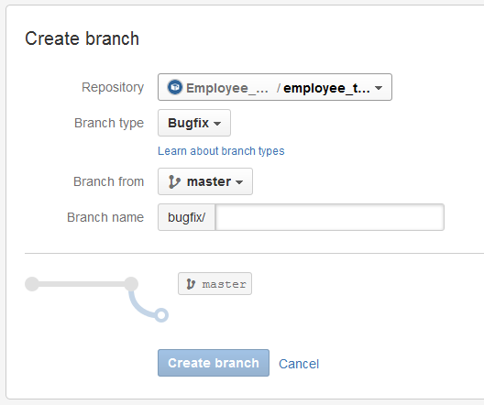
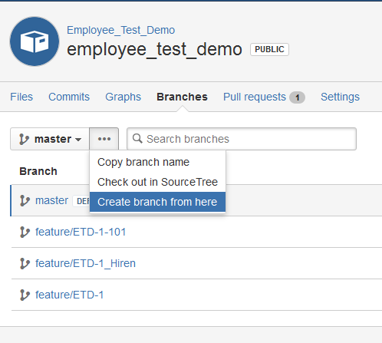
Branches
Several branch types have default branch naming prefixes.
Once it's created, Stash takes you to the file listing for the new branch.
You can now pull to your local repository and switch to the new branch.

Slide 19

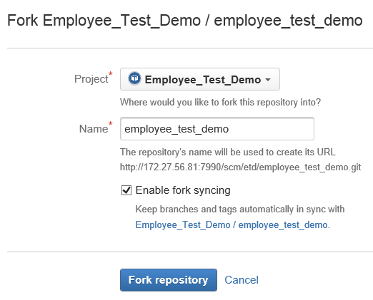
Creating Forks
Provide an alternative workflow to using branches.
You can also create personal forks and give other developers access to that using repository permissions.
You can ‘Enable fork syncing’ to have Stash automatically keep your fork up-to-date with changes in the upstream repository.

Slide 20
Pull Requests
Use when you are ready to start a discussion about your code changes
Provide the team with a quick and easy way to
review changes made on a branch,
discuss those changes, and
make further modifications
before the branch is merged back to master or your main development branch.

Slide 21
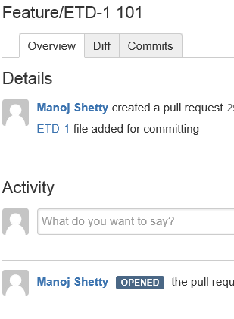
Discussing a Pull Requests
Overview
Captures all of the team's activity on the pull request in one place, right from the initial creation
Diff
Highlights the changes that will result when the merge occurs
Commits
Lists all the commits that will get merged.
You can add/reply a comment on the Overview tab.
So you can quickly see the files you may need to review.
The diff for a file shows which lines of code have been added, deleted or modified.
Stash auto-updates the Commits tab of the pull request, so you can see exactly which commits will be merged.

Slide 22
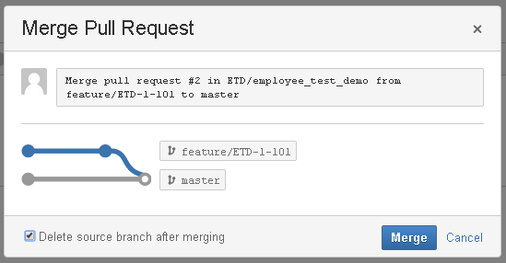
Merging a Pull Request
You can check Delete branch if you no longer need that branch in the repository.
The branch being merged will not be deleted if:
The branch is the default repository branch.
The user does not have permission to delete the branch.
The branch is subject to an open pull request.

Slide 23
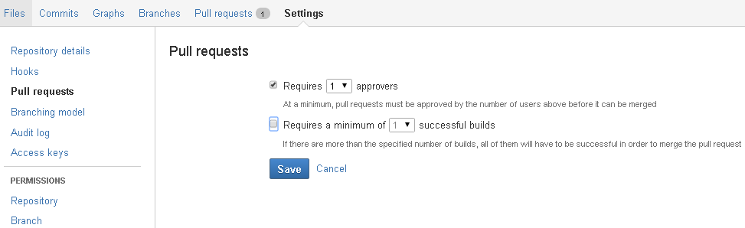
Checks for merging a pull request
Checks to control when a pull request can be merged.
Pull requests cannot be merged if the required checks have not been met.
Set separately on each repository in a Stash project.

Slide 24
Pull Request

Slide 25



JIRA / Bamboo Integration
Just mention the JIRA issue id while committing the source and it will integrate JIRA/Bamboo and Stash
Quick navigation to JIRA issue and Bamboo builds
Track the work progress of JIRA
Source Insight from JIRA
JIRA for user management

Slide 26
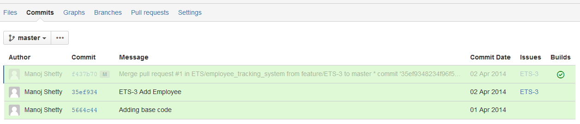
JIRA Integration
See the JIRA issues related to commits and pull requests

Slide 27
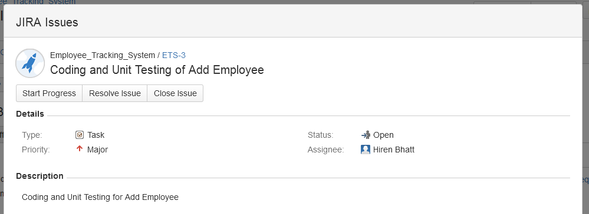
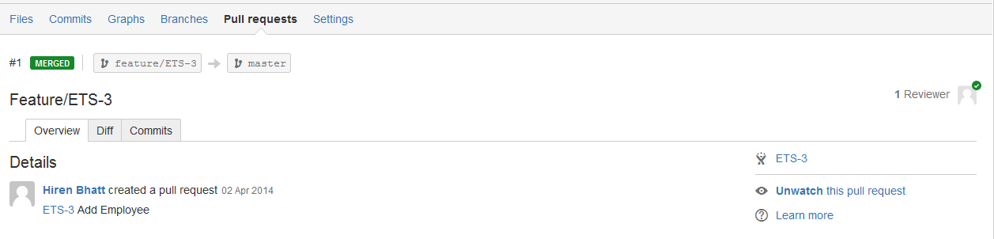
JIRA Integration…
Use JIRA issue keys in markdown

Slide 28
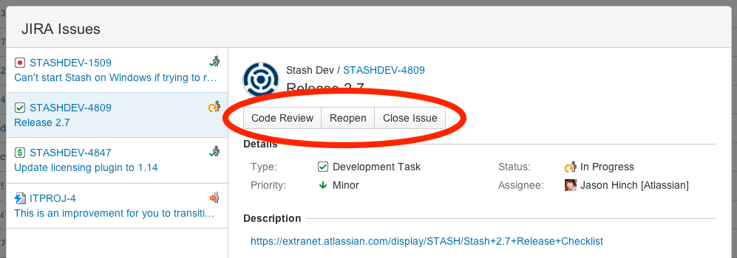
JIRA Integration…
Transition JIRA issues from within Stash

Slide 29
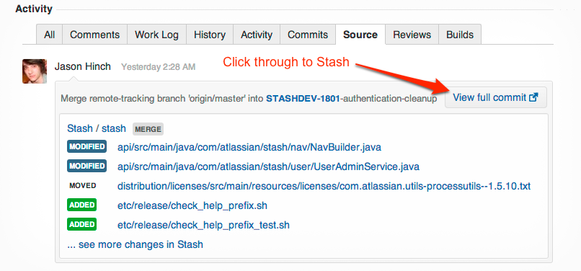
JIRA Integration…
See details of Stash commits in JIRA

Slide 30
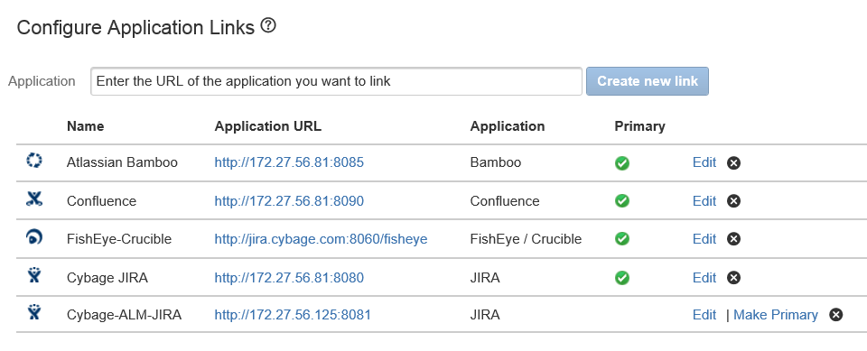
JIRA Integration…
Stash can link to more than one JIRA server at a time
Different teams can work with their own projects in different JIRA instances
Or a single team can link to issues across multiple JIRA servers.

Slide 31
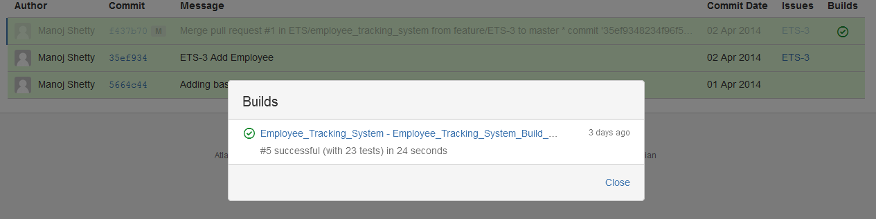
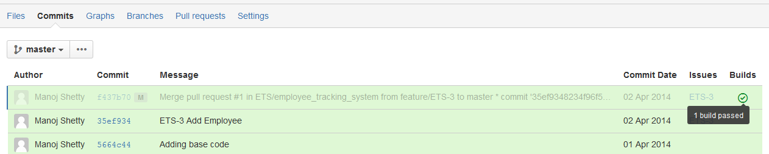
Bamboo Integration
Build results are published to Stash.
You can see the latest build result for a commit when viewing any commit or pull request.

Slide 32
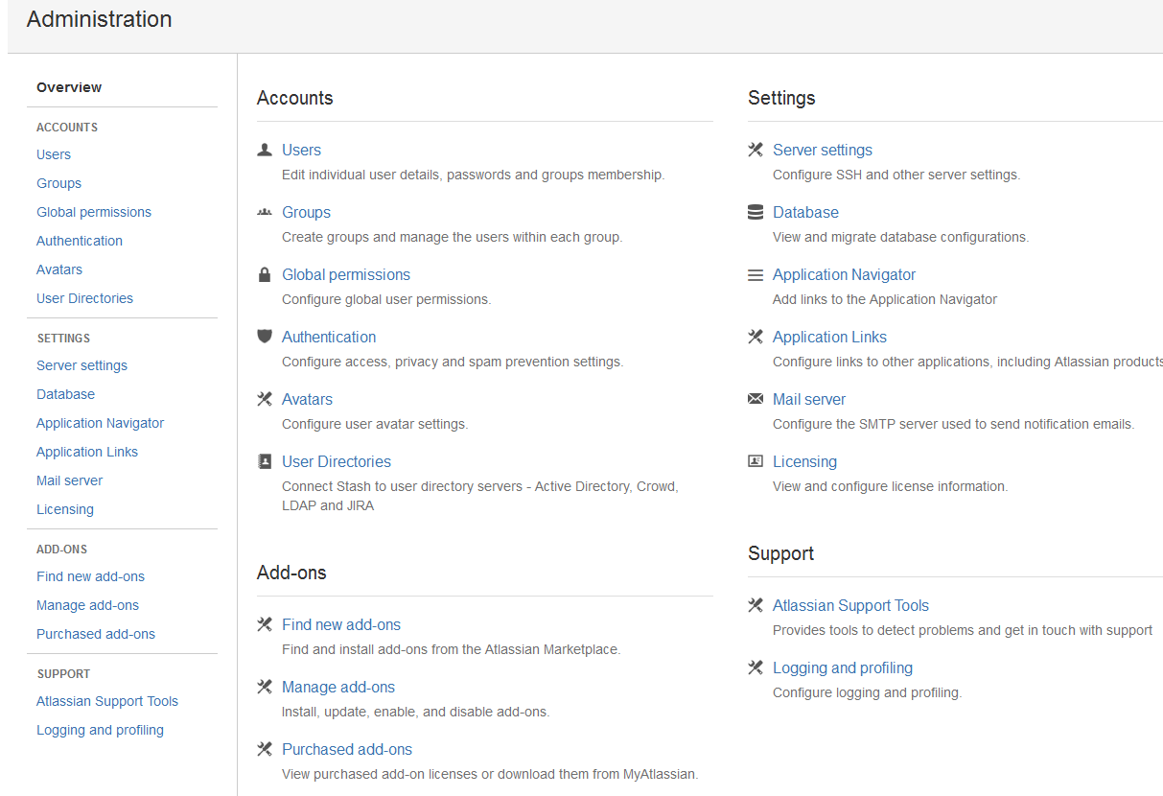
Administration in Stash

Slide 33
Administration in Stash

Slide 34

Any Questions?

Slide 35
Thank You!

